Slide 1
GovCon Office Hours – Ask The Experts
Franklin Turner
Alex Major
July 20, 2023

Slide 2
Who Are These People?
Partners in the Government Contracts and Global Trade practice at McCarter & English LLP
Significant experience handling “bet the company” litigation for multinational corporations to small businesses
Overseen compliance obligations addressing cybersecurity, SBA requirements, CAS and cost-accounting and the gambit of FAR/DFARS issues
Handled claims and bid protests valued, in the aggregate, in the tens of billions of dollars

Slide 3
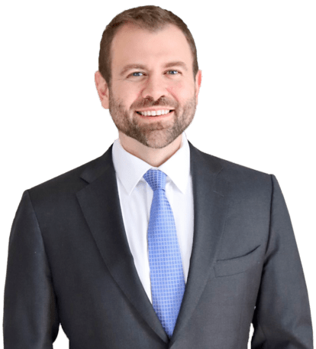
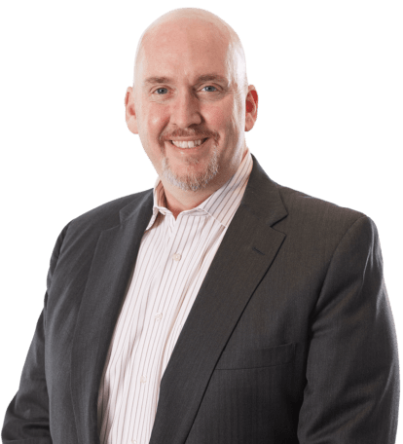
Questions? We are here to help!
Franklin C. Turner
Partner
(202) 753-3432
fturner@mccarter.com
Alexander W. Major
Partner
(202) 753-3440
amajor@mccarter.com
Protests
Claims
REAs
Teaming
Joint Venture
Anti-Collusion
Cybersecurity/ CMMC
CAS/Costs

